Slide 1
Data Link Layer Data Transfer
LECTURE 04

Slide 2
Content
User Data Plane
Sending user data
ISO/IEC 8802-2
LLC Primitives
IEEE 802.1AC-2016
Media Access Control (MAC) Service Definition
Parameter mapping between MAC-independent and MAC-dependent Primitives
IEEE 802.3-2022 Ethernet
MAC-dependent Primitives
Physical Layer Service primitives
IEEE 802.11-2020 primitives
MAC-dependent Primitives
Physical Layer Service primitives

Slide 3
Data Link Layer functions
Frame
The unit of data to be sent by a DLL protocol
Addressing
Identifying an entity on the DLL network
Data transfer
Medium access control
Accessing the physical medium to transmit frames
Flow control
Controlling the transmission speed of a sender
Error control
Detecting and correcting transmission errors
Management
Maintaining the data link layer

Slide 4
User Data Plane Data Transfer
Service Access Point (SAP) Primitives

Slide 5
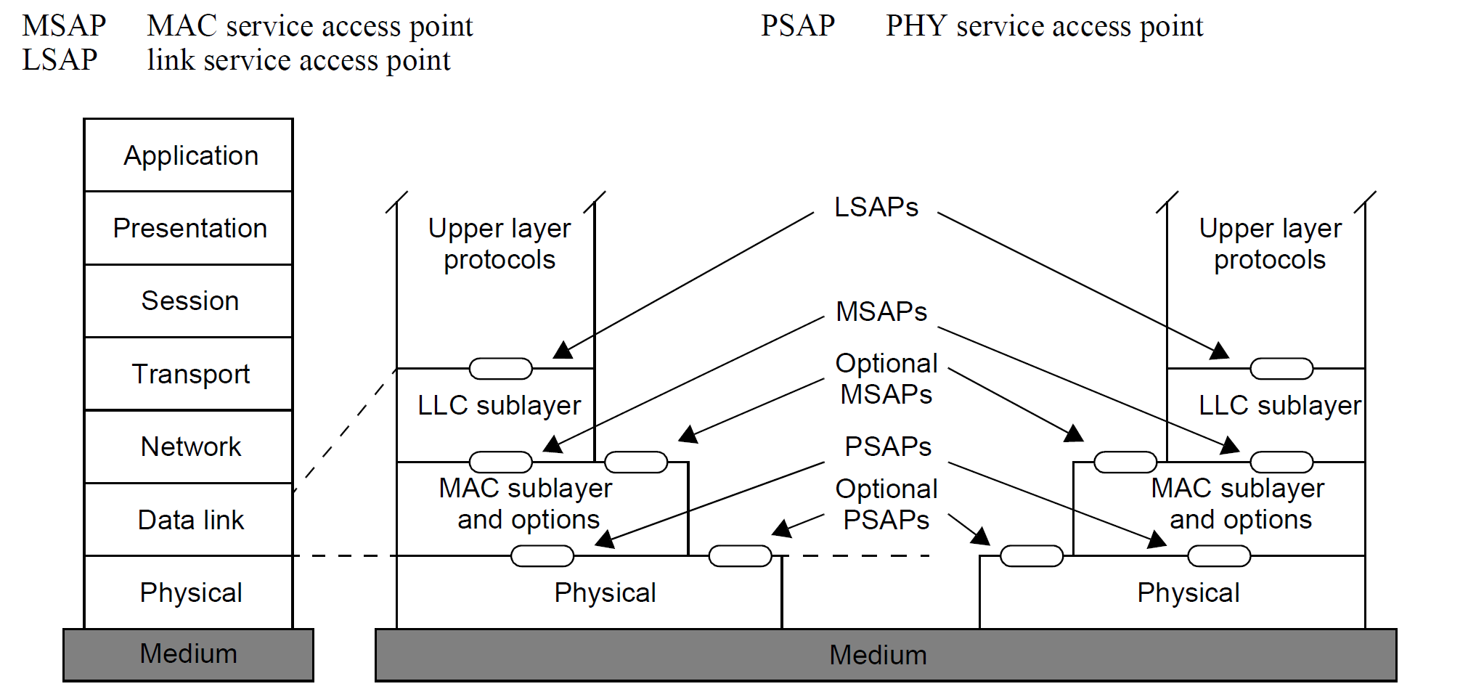
IEEE 802-2014 The reference Model for end stations

Slide 6
Data Link Layer IEEE 802 Standards for Data Link Layer
ISO/IEC 8802-2:1998 LLC primitives
IEEE 802.1AC-2016 Media Access Control (MAC) Service Definition
IEEE 802.1X-2020 Port-Based Network Access Control
IEEE 802.1AE-2018 Media Access Control (MAC) Security
IEEE 802.3-2022 IEEE Standard for Ethernet
IEEE 802.11-2020 Part 11: Wireless LAN Medium Access Control (MAC) and Physical Layer (PHY) Specifications

Slide 7
ISO/IEC 8802-2: 1998 Part 2: Logical link control

Slide 8
Data Link Layer ISO/IEC 8802-2:1998 Logical link control
Three forms of service
Type 1: Unacknowledged connectionless-mode services
IEEE 802.3 Ethernet
Type 2: Connection-mode services
3G/LTE/5G
Type 3: Acknowledged connectionless-mode services
IEEE 802.11 WLAN

Slide 9
Data Link Layer ISO/IEC 8802-2:1998 Logical link control
Data Transfer Primitives for Network Layer
Unacknowledged connectionless-mode data transfer
DL-UNITDATA.request
DL-UNITDATA.indication
Connection-mode data transfer
DL-DATA.request
DL-DATA.indication
Acknowledged connectionless-mode data transfer
DL-DATA-ACK.request
DL-DATA-ACK.indication
DL-DATA-ACK-STATUS.indication

Slide 10
Data Link Layer ISO/IEC 8802-2:1998 Logical link control
DL-UNITDATA.request/indication Parameters
Source_address (LLC SSAP: MAC SA)
Destination_address (LLC DSAP:MAC DA)
Data
Priority
The “source_address” and “destination_address” parameters provide at a minimum the logical concatenation of the MAC address field (SA and/or DA) and the LLC address field (SSAP and/or DSAP).

Slide 11
Data Link Layer ISO/IEC 8802-2:1998 Logical link control
Primitives for the MAC sublayer
MA-UNITDATA.request
MA-UNITDATA.indication
MA-UNITDATA-STATUS.indication
MA-UNITDATA.request
MSAP
MA-UNITDATA-STATUS.indication
(unable to support the request)
MA-UNITDATA.indication

Slide 12
Data Link Layer (DLL) ISO/IEC 8802-2 Logical Link Control
MA-UNITDATA.request/indication
source_address (SA)
An individual MAC sublayer entity address
destination_address (DA)
Either an individual or a group MAC sublayer entity address
routing_information (default: null)
The route desired for the data unit transfer (source-routing only – token ring)
mac_service_data_unit (LPD (or EPD))
priority
User Priority (0-7)
service_class (default: QoSAck)
the class of service desired for the data unit transfer

Slide 13
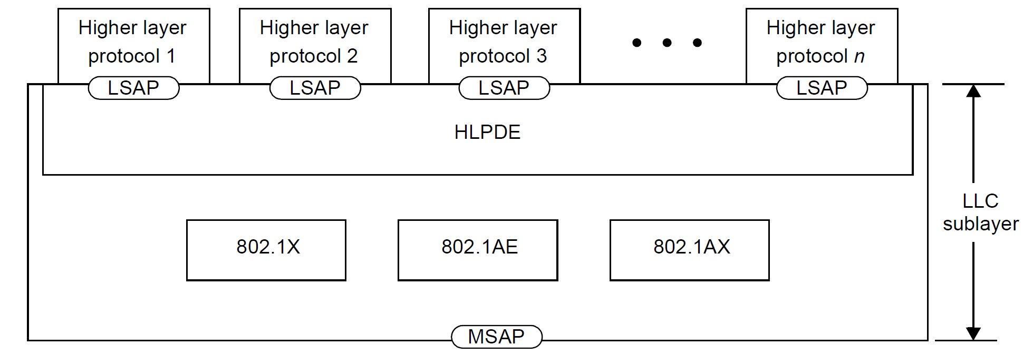
IEEE 802-2014 Reference Model description for end stations
LLC sublayer in 802 Reference Model
The higher layer protocol discrimination entity (HLPDE)
- EtherType protocol discrimination (EPD): the EtherType value made available to the LLC sublayer through the MSAP
- LLC protocol discrimination (LPD): the addresses defined in ISO/IEC 8802-2, including the Subnetwork Access Protocol (SNAP) format
The descriptions of EPD and LPD in IEEE Std 802-2014, 802.1AC, and 802.1Q are inconsistent.

Slide 14
IEEE 802.1AC-2016 Media Access Control (MAC) Service Definition
The MAC service definition was first standardized as ISO/IEC 15802-1:1995

Slide 15
Data Link Layer IEEE 802.1AC-2016 Media Access Control (MAC) Service Definition Introduction
During the history of IEEE 802, several different MAC types have been developed, all of which have a core of functionality [that is common to IEEE 802 MACs in general], but all of which also provide functionality [that extends beyond that common core].
Such differences can become an issue in LANs where more than one MAC technology is employed.
It was important at an early stage of MAC Bridge development to develop a clear definition of the MAC Service that would facilitate the definition of a common Bridging technology that could apply to all MAC types.

Slide 16
Data Link Layer IEEE 802.1AC-2016 Media Access Control (MAC) Service Definition Scope
The scope of this standard is to define the Media Access Control (MAC) Service provided by all IEEE 802 MACs, and the Internal Sublayer Service (ISS) provided within MAC Bridges.
MAC Relay Entity
(IEEE 802.1Q)
the client of the MAC Service
- Within a Bridge, the MAC Relay Entity
- A Logical Link Control (LLC) Entity
The LLC sublayer and protocol entities are described in IEEE Std 802-2014 and provides protocol identification, multiplexing, and demultiplexing to and from a number of clients that use a common MSAP.
<LSAP>
<EISS>
LLC (LPD or EPD)
Media Access Method
Independent Functions
(IEEE802.1Q 6.9)
<MSAP>: (end station)
<ISS>: (MAC Bridge)
802.1AC
Ethernet convergence function
Wireless LAN convergence function
<MSAP>
<MSAP>
Media Access Method
Specific Function
(IEEE 802.3-2022)
Media Access Method
Specific Function
(IEEE 802.11-2020)

Slide 17
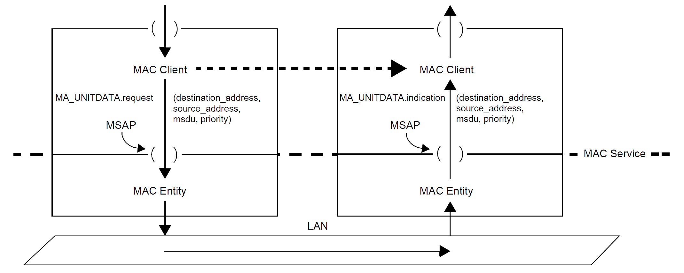
Data Link Layer IEEE 802.1AC-2012 Media Access Control (MAC) Service Definition
Figure 7-1—MAC entities, the MAC Service, and MAC Service users (clients)

Slide 18
Data Link Layer IEEE 802.1AC-2016 Media Access Control (MAC) Service Definition Overview of the MAC Service
The MAC Service provides a connectionless-mode service for the transparent transfer of data between MAC Service users
It makes invisible to these MAC Service users the way [that (supporting communications resources) are used to achieve this transfer].

Slide 19
Data Link Layer IEEE 802.1AC-2016 Media Access Control (MAC) Service Definition 8. Overview of the MAC Service
In particular, the MAC Service provides for the following:
a) Independence of the underlying MAC sublayer and Physical Layer
The MAC Service relieves MAC Service users from all concerns, [with the exception of quality of service (QoS) considerations], regarding the MAC technology that is available.
b) Transparency of transferred information
It does not restrict the content, format, or coding of the information, nor does it ever need to interpret its structure or meaning.
c) Priority selection
d) Addressing
To identify its MSAP and to specify the MSAP or MSAPs to which data is to be transferred
MAC address formats and encoding are specified in IEEE Std 802
e) Connectionless data transfer
MSDUs of limited length are delimited and transparently transmitted from one source MSAP to one or more destination MSAPs in a single MAC Service access, without establishing or later releasing a connection

Slide 20
Data Link Layer IEEE 802.1AC-2016 Media Access Control (MAC) Service Definition 14. MAC Services (for end station)
The MAC connectionless-mode transmission service is provided using a subset of the elements of the Internal Sublayer Service (ISS).
The primitives defined in this clause can be used to transmit an independent, self-contained MSDU from one MSAP to another MSAP in a single service access.
It is self-contained in that all of the information [required to deliver the MSDU] is presented to the MAC Service provider in a single service access.
No initial establishment or subsequent release of a connection is required.
The MAC Service provider is not required to maintain state information for flow control between specific combinations of MSAPs.

Slide 21
Data Link Layer IEEE 802.1AC-2016 Media Access Control (MAC) Service Definition 14.2 Service primitives and parameters
MA_UNITDATA.request/indication primitive Parameters
destination_address
The address of an individual MSAP or a group of MSAPs
source_address
The individual address of the source MSAP
mac_service_data_unit
the service user data (LPD or EPD format with length attribute)
Priority
The default priority value is 0
(0..7): 1 (BK(background)) < 0 (BE(best-effort)) < 2

Slide 22
Data Link Layer IEEE 802.1AC-2016 Media Access Control (MAC) Service Definition 14.2 Service primitives and parameters
The remaining parameters associated with the M_UNITDATA.request and M_UNITDATA.indication primitives of the ISS (frame_check_sequence, drop_eligible, service_access_point_identifier, and connection_identifier) are unspecified.

Slide 23
Data Link Layer IEEE 802.1AC-2016 Media Access Control (MAC) Service Definition 11. Internal Sublayer Service (for MAC Bridges)
M_UNITDATA.request/indication parameters
destination_address,
source_address,
mac_service_data_unit,
Priority,
drop_eligible (default:FALSE),
frame_check_sequence,
service_access_point_identifier,
connection_identifier
The values of the service_access_point_identifier and connection_identifier are purely local to the system [within which a given service request or service indication occurs], and are not conveyed to the communicating peer system.
The values are opaque to the user of the ISS and are not manipulated by that service user

Slide 24
Data Link Layer IEEE 802.1AC-2012 Media Access Control (MAC) Service Definition 12. Protocol discrimination and media
The ISS is Length/Type encoded (EPD format)
A Media Access Method Dependent convergence function (IEEE 802.3 Ethernet) [for a medium employing EPD] need not transform the mac_service_data_unit parameter when mapping to or from the ISS.
A Media Access Method Dependent convergence function (IEEE 802.11 WLAN (default format)) [for a medium employing LPD] shall perform the transformations specified in the following subclauses.
12.1 M_UNITDATA.request data transformation for LPD media
12.2. M_UNITDATA.indication data transformation for LPD media

Slide 25
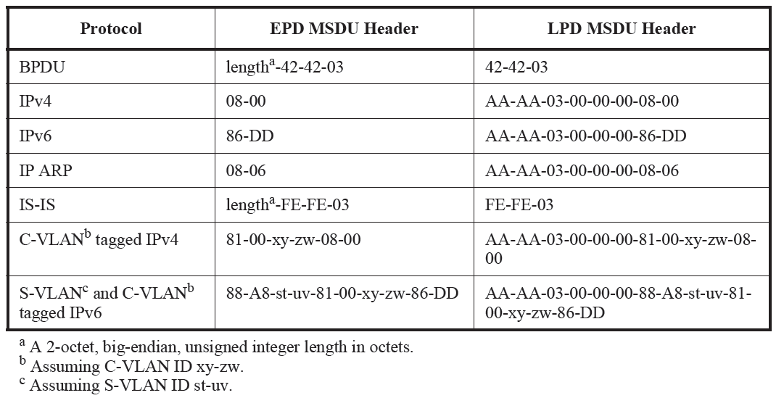
IEEE Std 802.11-2020 & IEEE Std 802.11ax-2021 Annex M (informative) EPD and LPD headers and the integration function
Table M-1—EPD and LPD MSDU headers
No EtherType is allocated
LLC Header (3octets): DSAP | SSAP | CTL,
DSAP/SSAP (0xAA): Subnetwork Access Protocol
CTL (0x03) : Unnumbered Information Frame
SNAP Header (5octets): OUI (3octets) | EtherType (2octects)
Length
- the range hexadecimal 0000–05DC (decimal 0-1500) inclusive
- (not specified – security encapsulation) the range hexadecimal 05DD–05FF (decimal 1501–1535) inclusive
Type
- the range hexadecimal 0600–FFFF (decimal 1536–65535) inclusive

Slide 26
IEEE 802.3-2022 MAC-dependent primitives
2. Media Access Control (MAC) service specification

Slide 27
Data Link Layer IEEE 802.3-2022 IEEE Standard for Ethernet 2. Media Access Control (MAC) service specification
2.2.4 Basic services
The MA_DATA.request and MA_DATA.indication service primitives are mandatory.

Slide 28
Data Link Layer IEEE 802.3-2022 IEEE Standard for Ethernet 2. Media Access Control (MAC) service specification
2.3.1 & 2.3.2 MA_DATA.request/ MA_DATA. Indication Parameters
destination_address,
It may specify either an individual or a group MAC entity address.
It has to contain sufficient information to create the DA field.
source_address (optional),
It has to specify an individual MAC address.
If it is omitted, the local MAC sublayer entity will insert a value associated with that entity.
mac_service_data_unit,
It specifies the MAC service data unit to be transmitted by the MAC sublayer entity.
There is sufficient information associated with the mac_service_data_unit for the MAC sublayer entity to determine the length of the data unit.
frame_check_sequence (optional)
If it is omitted, the local MAC sublayer entity will compute this field (CRC value) and append it to the end of the frame.
reception_status (indication only)
It is used to pass status information to the MAC client entity

Slide 29
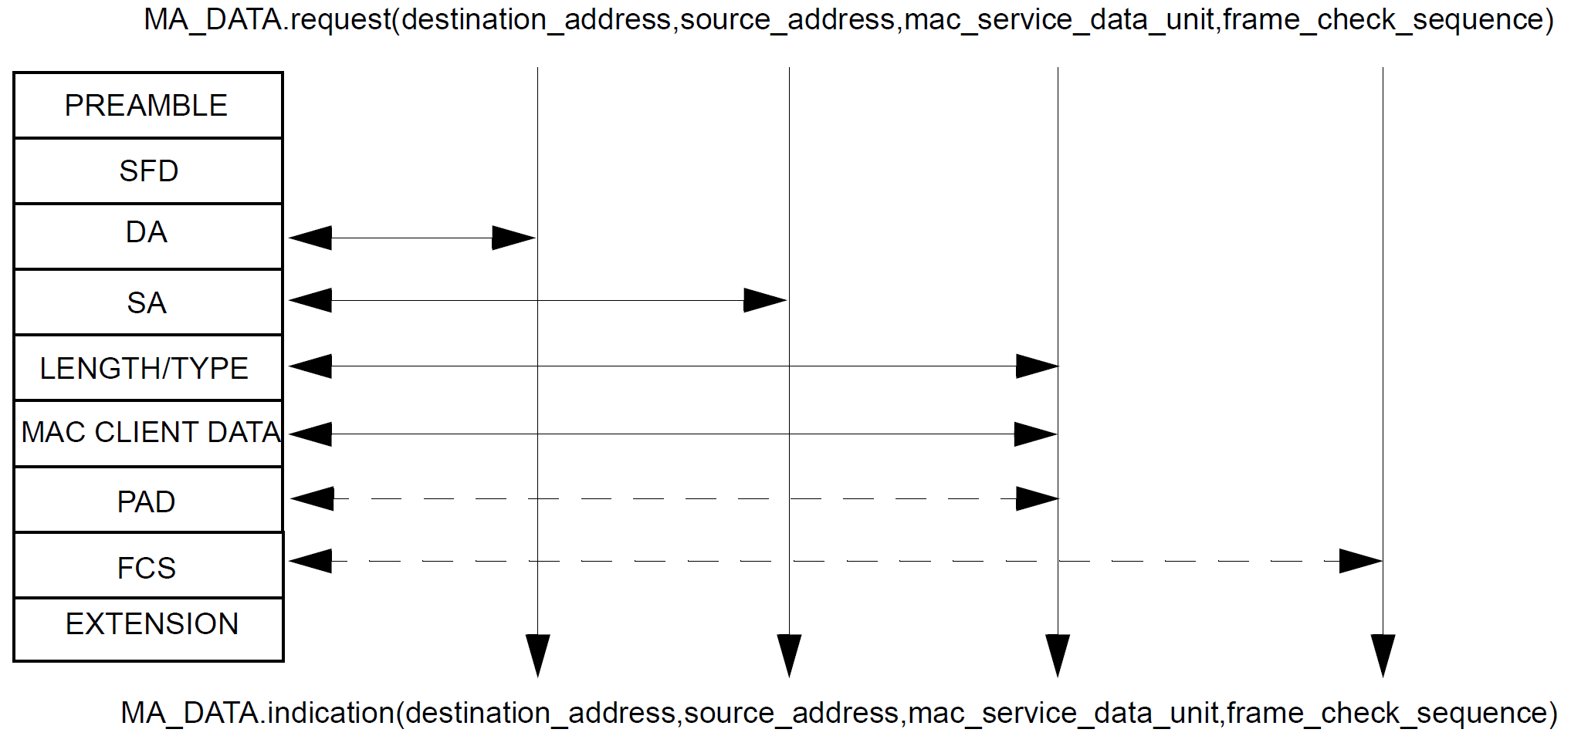
MAC Sublayer Standards 802.3-2022 Ethernet 3.1.2 Service interface mappings
Figure 3–2—Service primitive mappings

Slide 30
Data Link Layer IEEE 802.3-2022 IEEE Standard for Ethernet 2. Media Access Control (MAC) service specification
2.3.1.5 Additional comments
The mapping [between the MA_UNITDATA.request primitive specified in IEEE Std 802.1AC for end stations (MSAP) and the MA_DATA.request primitive specified here] is as follows:
a) The user_priority parameter specified for MA_UNITDATA.request is not relevant for IEEE 802.3 operation and is ignored by MA_DATA.request.
b) The access_priority parameter specified for MA_UNITDATA.request is not relevant for IEEE 802.3 operation and is ignored by MA_DATA.request.
IEEE 802.1AC-2016 does not contain the access_priority parameters
The access_priority parameter is defined in IEEE Std 802.1D.
c) The frame_check_sequence parameter is not present for MA_UNITDATA.request.

Slide 31
Data Link Layer IEEE 802.3-2022 IEEE Standard for Ethernet 2. Media Access Control (MAC) service specification
2.3.1.5 Additional comments
The mapping [between the M_UNITDATA.request primitive specified in IEEE Std 802.1AC for MAC Bridges (ISS) and the MA_DATA.request primitive specified here] is as follows:
d) The frame_type parameter specified for M_UNITDATA.request is not relevant for IEEE 802.3 operation and is ignored by MA_DATA.request.
e) The mac_action parameter specified for M_UNITDATA.request is not relevant for IEEE 802.3 operation and is ignored by MA_DATA.request.
f) The user_priority parameter specified for M_UNITDATA.request is not relevant for IEEE 802.3 operation and is ignored by MA_DATA.request.
g) The access_priority parameter specified for M_UNITDATA.request is not relevant for IEEE 802.3 operation and is ignored by MA_DATA.request.

Slide 32
IEEE 802.3-2022 Physical Layer Signaling
6. Physical Signaling (PLS) service specifications

Slide 33
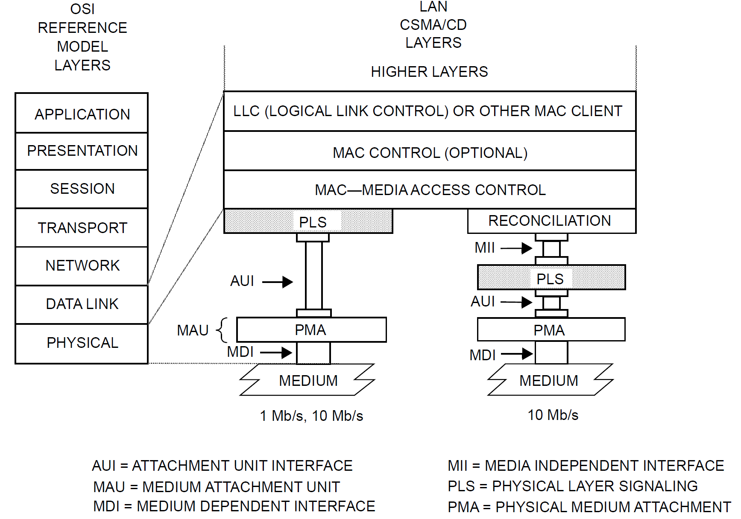
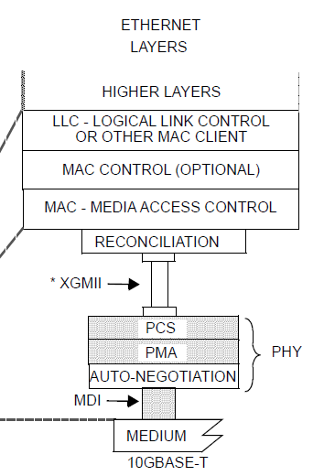
Data Link Layer IEEE 802.3-2022 Ethernet 6. Physical Signaling (PLS) service specifications
The Reconciliation sublayer maps the signals provided at the MII/GMII/XGMII/XLGMII/CGMII to the PLS service primitives defined in Clause 6.
- 25GMII/50GMII/200GMII/400GMII
- XGMII (10Gbps), XLGMII(40Gpbs), CGMII(100Gbps)
GMII: GIGABIT MEDIA INDEPENDENT INTERFACE
Figure 6–1—PLS service specification relationship to the ISO/IEC Open Systems Interconnection (OSI) reference model and the IEEE 802.3 CSMA/CD LAN model

Slide 34
Data Link Layer IEEE 802.3-2022 Ethernet 6. Physical Signaling (PLS) service specifications
6.2.3 Overview of interactions
The primitives associated with the MAC sublayer to PLS sublayer interface fall into two basic categories:
a) Service primitives that support MAC peer-to-peer interactions.
b) Service primitives that have local significance and support sublayer-to-sublayer interactions.
The following primitives are grouped into these two categories:
a) Peer-to-Peer
PLS_DATA.request
PLS_DATA.indication
b) Sublayer-to-Sublayer
PLS_CARRIER.indication
PLS_SIGNAL.indication
PLS_DATA_VALID.indication

Slide 35
Data Link Layer IEEE 802.3-2022 Ethernet 6. Physical Signaling (PLS) service specifications
6.3.1 Peer-to-peer service primitives
6.3.1.1.2 PLS_DATA.request (OUTPUT_UNIT)
The OUTPUT_UNIT parameter can take on one of three values:
ONE, ZERO, or DATA_COMPLETE
The OUTPUT_UNIT parameter represent a single data bit.
The DATA_COMPLETE value signifies [that the Media Access Control sublayer has no more data to output].
6.3.1.2.2 PLS_DATA. indicate (INPUT_UNIT)
The INPUT_UNIT parameter can take one of two values each representing a single bit: ONE or ZERO.

Slide 36
Data Link Layer IEEE 802.3-2022 Ethernet 7. Physical Signaling (PLS) and Attachment Unit Interface (AUI) specifications
6.3.2 Sublayer-to-sublayer service primitives
6.3.2.1.2 PLS_CARRIER.indication (CARRIER_STATUS)
The CARRIER_STATUS parameter can take one of two values:
CARRIER_ON or CARRIER_OFF.
The CARRIER_ON value indicates that the DTE Physical Layer had received an input message or a signal_quality_error message from the MAU.
The CARRIER_OFF value indicates that the DTE Physical Layer had received an input_idle message and is not receiving an SQE signal_quality_error message from the MAU.
6.3.2.1.3 When generated
The PLS_CARRIER.indication service primitive is generated whenever CARRIER_STATUS makes a transition from CARRIER_ON to CARRIER_OFF or vice versa.

Slide 37
Data Link Layer IEEE 802.3-2022 Ethernet 7. Physical Signaling (PLS) and Attachment Unit Interface (AUI) specifications
6.3.2 Sublayer-to-sublayer service primitives
6.3.2.2.2 PLS_SIGNAL.indication (SIGNAL_STATUS)
The SIGNAL_STATUS parameter can take one of two values:
SIGNAL_ERROR or NO_SIGNAL_ERROR.
The SIGNAL_ERROR value indicates to the MAC sublayer [that the PLS has received a signal_quality_error message from the MAU].
The NO_SIGNAL_ERROR value indicates [that the PLS has ceased to receive signal_quality_error messages from the MAU.
6.3.2.2.3 When generated
The PLS_SIGNAL.indication service primitive is generated whenever SIGNAL_ STATUS makes a transition from SIGNAL_ERROR to NO_SIGNAL_ERROR or vice versa.

Slide 38
Data Link Layer IEEE 802.3-2022 Ethernet 7. Physical Signaling (PLS) and Attachment Unit Interface (AUI) specifications
6.3.2 Sublayer-to-sublayer service primitives
6.3.2.3.2 PLS_DATA_VALID.indication (DATA_VALID_STATUS)
The DATA_VALID_STATUS parameter can take one of two values:
DATA_VALID or DATA_NOT_VALID.
The DATA_VALID value indicates [that the INPUT_UNIT parameter of the PLS_DATA.indication primitive contains valid data of an incoming frame].
The DATA_NOT_VALID value indicates [that the INPUT_UNIT parameter of the PLS_DATA.indication primitive does not contain valid data of an incoming frame].
6.3.2.3.3 When generated
The PLS_DATA_VALID.indication service primitive is generated whenever the DATA_VALID_STATUS parameter makes a transition from DATA_VALID to DATA_NOT_VALID or vice versa.

Slide 39
Summary Data Transfer using IEEE 802.3

Slide 40
IEEE 802.3 Ethernet Data Transfer
IP
ARP
LLC or MAC Bridge (MAC Client)
The MAC Client should transform the user data (to EPD or LPD) before calling the MA-UNITDATA.request
MA-UNITDATA.request
IEEE 802.1AC-2016
14. MAC Service
13.1 Ethernet convergence function
MA-DATA.request
IEEE 802.3-2022 Ethernet
2. Media Access Control (MAC) service specification
2.2 Overview of the service
2.3 Detailed service specification
LSAP
LLC (EPD)
MSAP
IEEE 802.1AC MAC service
MSAP
IEEE 802.3 Ethernet

Slide 41
IEEE 802.3 Ethernet Data Transfer
MA-UNITDATA.request
The MAC should make the MAC frame for the primitive as well as the Physical Layer frame
MA-UNITDATA.request(DA,SA,MSDU(EPD)withLengthAtrribute), Priority(0))
MA_DATA.request(DA,SA, MSDU(EPD)withLengthAtrribute, FCS(NULL))
DA
SA
EtherType | DATA | PAD
(Length ≥ 64)
FCS
Preamble
SFD
MPDU
Extension
(1Gbps half-duplex only)

Slide 42
IEEE 802.3 Ethernet Data Transfer
DA
SA
EtherType | DATA | PAD
(Length ≥ 64)
FCS
Preamble
SFD
Extension
(1Gbps half-duplex only)
IEEE 802.3 Ethernet MAC: TX
PLS_CARRIER.indication (CARRIER_STATUS=CARRIER_OFF)
PLS_DATA.request(ONE or ZERO)
PLS_CARRIER.indication (CARRIER_STATUS=CARRIER_ON)
…..
PLS_DATA.request(DATA_COMPLETE)
PLS_CARRIER.indication (CARRIER_STATUS=CARRIER_OFF)
DATA
DATA
…
DATA_VALID
DATA_NOT_VALID
CARRIER_ON
CARRIER_OFF
DATA
DATA
DATA_COMPLETE
IEEE 802.3 Ethernet MAC: RX
PLS_CARRIER.indication (CARRIER_STATUS=CARRIER_ON)
PLS_DATA_VALID.indication (DATA_VALID_STATUS=DATA_VALID)
PLS_DATA.indication(ONE or ZERO)
…..
PLS_DATA_VALID.indication (DATA_VALID_STATUS=DATA_NOT_VALID)
PLS_CARRIER.indication (CARRIER_STATUS=CARRIER_OFF)
…
CARRIER_ON
CARRIER_OFF
CARRIER_OFF

Slide 43
IEEE 802.11 MAC-dependent primitives
5. MAC service definition
5.2 MAC data service specification

Slide 44
Data Link Layer IEEE 802.11-2020 Wireless LAN MAC & PHY Specifications 5. MAC service definition
This service provides peer LLC sublayer entities or IEEE 802.1Q bridge ports with the ability to exchange MSDUs.
The local MAC uses the underlying PHY-level services to transport an MSDU to a peer MAC entity.
Such asynchronous MSDU transport is performed on a connectionless basis.
By default, MSDU transport is on a best-effort basis.
The QoS facility uses a traffic identifier (TID) to specify differentiated services on a per-MSDU basis.
There are no guarantees that the submitted MSDU will be delivered successfully.

Slide 45
Data Link Layer IEEE 802.11-2020 Wireless LAN MAC & PHY Specifications 5. MAC service definition
There are two service classes available in a QoS STA:
QoSAck and QoSNoAck.
The service classes are used to signal if the MSDU is to be transmitted with or without using the MAC-level acknowledgment.

Slide 46
Data Link Layer IEEE 802.11-2020 Wireless LAN MAC & PHY Specifications 5. MAC service definition
5.1.4 MSDU format
Logical Link Control (LLC) sublayer entities use the MAC sublayer service to exchange PDUs with peer LLC sublayer entities.
These PDUs are termed MAC sublayer SDUs (MSDUs) when sent to the MAC sublayer.
There are two LLC sublayer protocols used (see IEEE Std 802):
LLC Protocol Discrimination (LPD) (see ISO/IEC 8802-2:1998), and
Ethertype Protocol Discrimination (EPD) (see IEEE Std 802.3-2018).

Slide 47
Data Link Layer IEEE 802.11-2020 Wireless LAN MAC & PHY Specifications 5.2 MAC data service specification
The IEEE 802.11 MAC supports the following service primitives as defined in ISO/IEC 8802-2:1998 LLC
MA-UNITDATA.request
MA-UNITDATA.indication
MA-UNITDATA-STATUS.indication
IEEE Std 802.11 places restrictions and semantics on the parameter values for these primitives.

Slide 48
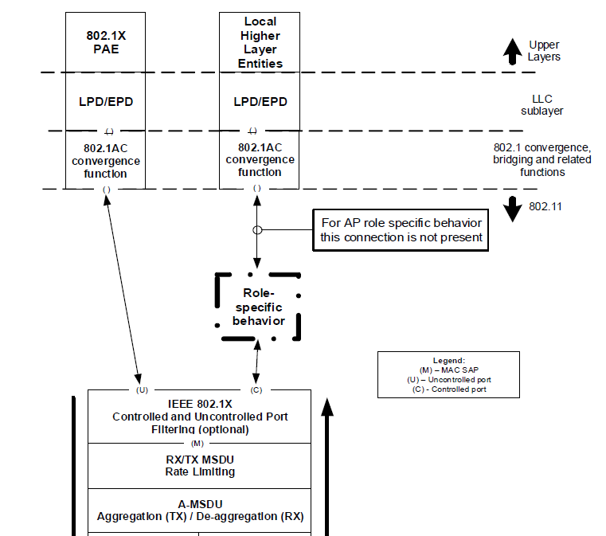
Data Link Layer IEEE 802.11-2020 Wireless LAN MAC & PHY Specifications 5.1.5 MAC data service architecture
IEEE 802.AC1-2016 MSAP
IEEE 802.11-2020 MSAP
Figure 5-1—MAC data plane architecture

Slide 49
Data Link Layer IEEE 802.11-2020 Wireless LAN MAC & PHY Specifications 5.2.3 MA-UNITDATA.request
5.2.3.1 MA-UNITDATA.request Function
This primitive requests a transfer of an MSDU from a local LLC sublayer entity to a single peer LLC sublayer entity or bridge port, or multiple peer LLC sublayer entities or bridge port in the case of group addresses.
5.2.3.3 When generated
This primitive is generated by the LLC sublayer entity when an MSDU is to be transferred to a peer LLC sublayer entity or entities or to a peer bridge or bridges

Slide 50
Data Link Layer IEEE 802.11-2020 Wireless LAN MAC & PHY Specifications 5.2.3 MA-UNITDATA.request & 5.2.4 MA-UNITDATA.indication
5.2.3.2 & 5.2.4.2 MA-UNITDATA.request/indication Parameters
source address,
destination address,
routing information (null),
data,
reception status (indication only; always “success” (failures (discarded))
priority (0.7,8..15),
drop eligible (TRUE/FALSE),
service class (QoSAck/QoSNoAck),
station vector (a set of service_access_point_identifiers),
If dot11GLKImplemented (FALSE), it is null or not present
MSDU format (EPD or LPD)

Slide 51
Data Link Layer IEEE 802.1AC-2016 Media Access Control (MAC) Service Definition 13.2 Wireless LAN convergence function
13.2.4 IEEE 802.11 parameter mapping
13.2.4.1 IEEE 802.11 parameter mapping (requests (M→MA))
a) The destination_address, source_address, and priority parameters are passed unaltered as the destination address, source address and priority, respectively.
b) The M_UNITDATA mac_service_data_unit parameter (EPD) is translated (EPD→LPD) and passed as the MA-UNITDATA or DS-UNITDATA data parameter.
c) The ISS M_UNITDATA drop_eligible, frame_check_sequence, service_access_point_identifier, and connection_identifier parameters are ignored.
d) The IEEE 802.11 MA-UNITDATA or DS-UNITDATA routing information parameter is null.
e) The value of the IEEE 802.11 MA-UNITDATA or DS-UNITDATA service class parameter is QoSAck.

Slide 52
Data Link Layer IEEE 802.1AC-2016 Media Access Control (MAC) Service Definition 13.2 Wireless LAN convergence function
13.2.4 IEEE 802.11 parameter mapping
13.2.4.2 IEEE 802.11 parameter mapping (indications (MA→M))
a) The destination_address, source_address, and priority parameters are passed unaltered as the destination address, source address and priority, respectively.
b) The MA-UNITDATA or DS-UNITDATA data parameter is translated (LPD→ EPD) and passed as the mac_service_data_unit parameter.
c) The drop_eligible is FALSE
d) The frame_check_sequence, service_access_point_identifier, and connection_identifier parameters are null.
e) The MA-UNITDATA or DS-UNITDATA routing information, reception status, and service class parameters are ignored.

Slide 53
Data Link Layer IEEE 802.11-2020 Wireless LAN MAC & PHY Specifications 5.2.5 MA-UNITDATA-STATUS.indication
5.2.5.1 MA-UNITDATA-STATUS.indication Function
This primitive has local significance and provides the LLC sublayer or bridge port with status information for the corresponding preceding MA-UNITDATA.request primitive.
5.2.5.3 When generated
The MA-UNITDATA-STATUS.indication primitive is passed from the MAC sublayer entity to the LLC sublayer entity or bridge port to indicate the status of the service provided for the corresponding MA-UNITDATA. request primitive.

Slide 54
Data Link Layer IEEE 802.11-2020 Wireless LAN MAC & PHY Specifications 5.2.5 MA-UNITDATA-STATUS.indication
5.2.5.2 MA-UNITDATA-STATUS.indication Parameters
source address,
as specified in the associated MAUNITDATA.request primitive
destination address,
as specified in the associated MAUNITDATA.request primitive
transmission status,
passing status information back to the local requesting LLC sublayer entity or bridge port.
IEEE Std 802.11 specifies the following values for transmission status:
a) Successful. b)-o) Undeliverable (with reason: (excessive data length))
provided priority,
the priority used for the associated data unit transfer only if “Successful”.
(Contention or an integer in the range 0 to 15)
provided service class
the class of service for the associated data unit transfer only if “Successful”.

Slide 55
IEEE 802.11-2020 Physical Layer SAP
8. PHY service specification

Slide 56
Data Link Layer IEEE 802.11-2020 Wireless LAN MAC & PHY Specifications 8. PHY service specification
8.1 Scope of PHY services
The PHY services provided to the MAC are described in this clause.
Different PHYs are defined as part of this standard.
15 DSSS, 16.HR/DSSS, 17.OFDM, 18. ERP, 19. HT, 20, DMG, 21. VHT, 22. TVHT,
23. S1G, 24. CDMG, 25. CMMG, 27. HE (11ax-2021), 32. NGV (11bd-2022)
Each PHY can consist of the following protocol functions:
a) A function that defines a method of mapping the MPDUs into a framing format suitable for sending and receiving user data and management information between two or more STAs.
b) A function that defines the characteristics of, and method of transmitting and receiving data through, a WM between two or more STAs.

Slide 57
Data Link Layer IEEE 802.11-2020 Wireless LAN MAC & PHY Specifications 8. PHY service specification
8.2 PHY functions
Most PHY definitions contain two functional entities: the PHY function and the layer management function.
The PHY service is provided to the MAC entity at the STA through a SAP.
It called the PHY SAP.

Slide 58
Data Link Layer IEEE 802.11-2020 Wireless LAN MAC & PHY Specifications 8.3 Detailed PHY service specifications
8.3.2 Overview of the service
The function of the PHY is to provide a mechanism for transferring MPDUs between two or more STAs.
8.3.3 Overview of interactions
The primitives [associated with communication between the MAC sublayer and the PHY] fall into two basic categories:
a) Service primitives that support MAC peer-to-peer interactions
b) Service primitives that have local significance and support sublayer-to-sublayer interactions

Slide 59
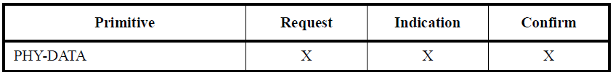
Data Link Layer IEEE 802.11-2020 Wireless LAN MAC & PHY Specifications 8.3 Detailed PHY service specifications
8.3.4.1 PHY SAP peer-to-peer service primitives
Table 8-1—PHY SAP peer-to-peer service primitives
Request
PSAP
Peer PSAP
Confirm
Indication

Slide 60
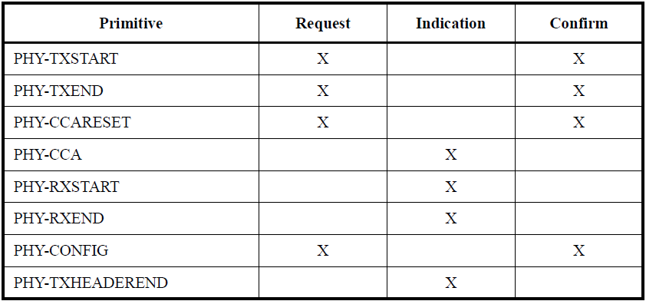
Data Link Layer IEEE 802.11-2020 Wireless LAN MAC & PHY Specifications 8.3 Detailed PHY service specifications
Request
PSAP
8.3.4.2 PHY SAP inter-(sub)layer service primitives
Confirm
Indication
Table 8-2—PHY SAP inter-(sub)layer service primitives

Slide 61
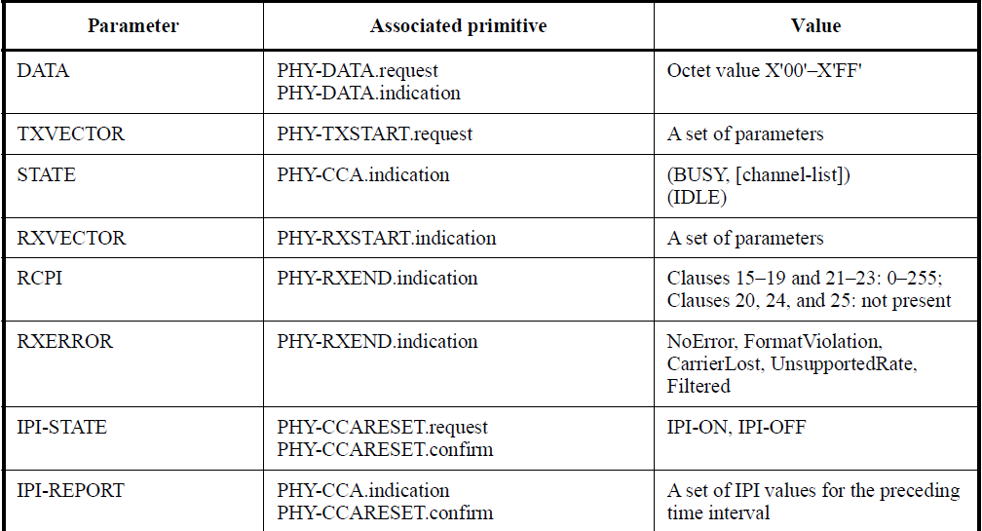
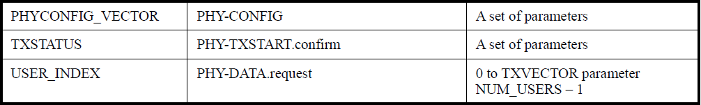
Data Link Layer IEEE 802.11-2020 Wireless LAN MAC & PHY Specifications 8.3 Detailed PHY service specifications
Table 8-3—PHY SAP service primitive parameters
8.3.4.3 PHY SAP service primitives parameters
RCPI received channel power indicator
IPI idle power indicator

Slide 62
Data Link Layer IEEE 802.11-2020 Wireless LAN MAC & PHY Specifications 8.3 Detailed PHY service specifications
8.3.5.2 PHY-DATA.request
PHY-DATA.request(DATA, USER_INDEX)
The DATA parameter is an octet of value X'00' to X'FF’.
The USER_INDEX parameter is present for a VHT MU PPDU and indicates the index of the user in the TXVECTOR to which the accompanying DATA octet applies.
typically identified as u for a VHT STA,
It can be issued only following a transmit initialization response (a PHY-TXSTART.confirm primitive) from the PHY
8.3.5.4 PHY-DATA.confirm
PHY-DATA.confirm
The PHY issues this primitive in response to every PHY-DATA.request primitive issued by the MAC sublayer.

Slide 63
Data Link Layer IEEE 802.11-2020 Wireless LAN MAC & PHY Specifications 8.3 Detailed PHY service specifications
8.3.5.3 PHY-DATA.indication
PHY-DATA.indication(DATA)
The DATA parameter is an octet of value X'00' to X'FF’.
The PHY-DATA.indication primitive is generated by a receiving PHY entity to transfer the received octet of data to the local MAC entity.
The time between receipt of the last bit of the last provided octet from the WM and the receipt of this primitive by the MAC entity is aRxPHYDelay.

Slide 64
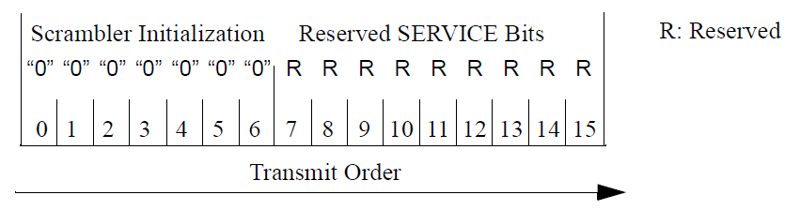
Data Link Layer IEEE 802.11-2020 Wireless LAN MAC & PHY Specifications 8.3 Detailed PHY service specifications
Figure 17-6—SERVICE field bit assignment
8.3.5.5 PHY-TXSTART.request (TXVECTOR)
8.3.5.6 PHY-TXSTART.confirm (TXSTATUS)
8.3.5.9 PHY-TXHEADEREND.indication
It is generated by a transmitter PHY entity at the end of transmission of the last symbol containing the PHY header
8.3.5.7 PHY-TXEND.request
8.3.5.8 PHY-TXEND.confirm (SCRAMBLER_OR_CRC)
the Scrambler Initialization value in the Service field after scrambling ([B0:B6] of the Service field]) of the frame.

Slide 65
Data Link Layer IEEE 802.11-2016 Physical Layer SAP
8.3.5.10 PHY-CCARESET.request (IPI-STATE: IPI-ON/IPI-OFF)
This primitive is generated by the MAC sublayer for the local PHY entity at the end of a NAV and at a time after each MAC slot boundary
8.3.5.11PHY-CCARESET.confirm (IPI-REPORT: a set of IPI values)
8.3.5.12 PHY-CCA.indication (STATE, IPI-REPORT, channel-list)
STATE: BUSY or IDLE
Channel-list: primary/secondary/ secondary40/ secondary80
It is generated when the state of the primary channel is changed within aCCATime from channel idle to channel busy or from channel busy to channel idle or when the elements of the channel-list parameter change
NAV Network Allocation Vector
IPI Idle Power Indicator

Slide 66
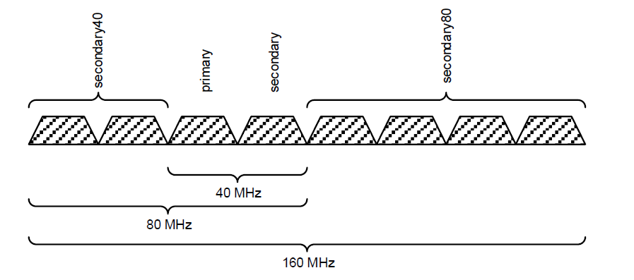
Data Link Layer IEEE 802.11-2020 Wireless LAN MAC & PHY Specifications 8.3.5.12.2 Semantics of the service primitive
Figure 8-1—The channel-list parameter entry for 40 MHz, 80 MHz, and 160 MHz channel width

Slide 67
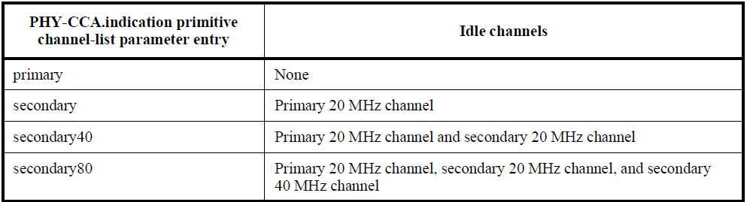
Data Link Layer IEEE 802.11-2020 Wireless LAN MAC & PHY Specifications 8.3 Detailed PHY service specifications 10.23.2.5 EDCA channel access in a VHT or TVHT BSS
Table 10-17—Channels indicated idle by the channel-list parameter for VHT or TVHT BSSs
If the MAC receives a PHY-CCA.indication primitive with the channel-list parameter present, the channels considered idle are defined in Table 10-17.

Slide 68
Data Link Layer IEEE 802.11-2020 Wireless LAN MAC & PHY Specifications 8.3 Detailed PHY service specifications
8.3.5.13 PHY-RXSTART.indication (RXVECTOR)
8.3.5.14 PHY-RXEND.indication (RXERROR, RCPI)
The RXERROR parameter can convey NoError or one or more values indicating an error condition.
If present, RCPI is a measure of the received RF power averaged over all of the receive chains in the data portion of a received frame.
RCPI is an included parameter only when dot11RadioMeasurementActivated (TRUE) and the PHY is not a DMG, CDMG, or CMMG PHY.

Slide 69
Data Link Layer IEEE 802.11-2020 Wireless LAN MAC & PHY Specifications 4.3.13 High-throughput (HT) STA
An HT STA supports HT features as identified in
19. High-throughput (HT) PHY specification
An HT STA operating in the 5 GHz band
17. Orthogonal frequency division multiplexing (OFDM) PHY specification
An HT STA operating in the 2.4 GHz band
16. High rate direct sequence spread spectrum (HR/DSSS) PHY specification
18. Extended Rate PHY (ERP) specification

Slide 70
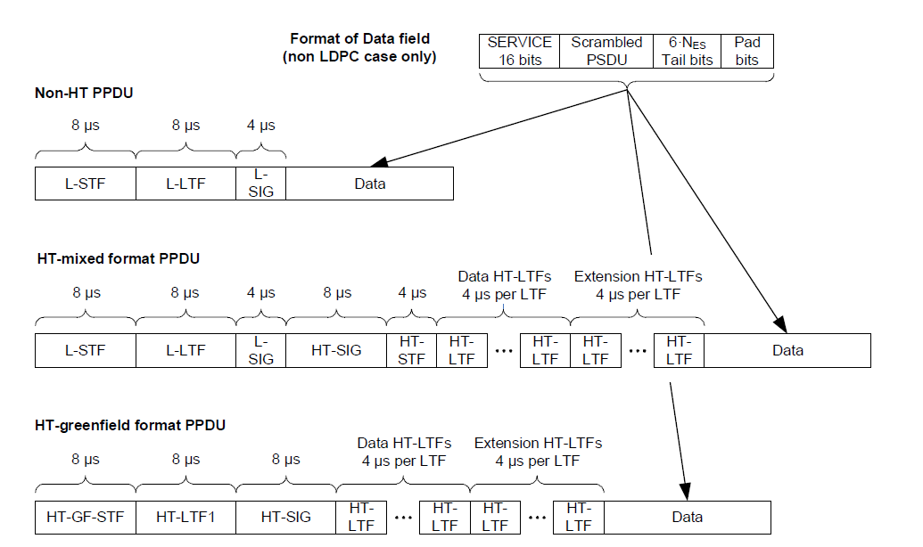
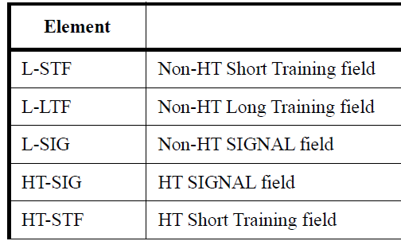
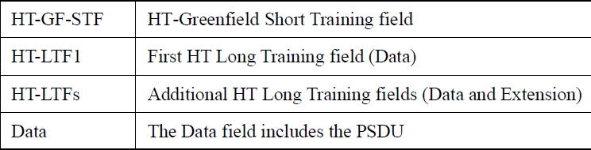
Data Link Layer IEEE 802.11-2020 Wireless LAN MAC & PHY Specifications 19. High-throughput (HT) PHY specification
FORMAT: NON_HT
FORMAT: HT_MF
FORMAT: HT_GF
Figure 19-1—HT PPDU format

Slide 71
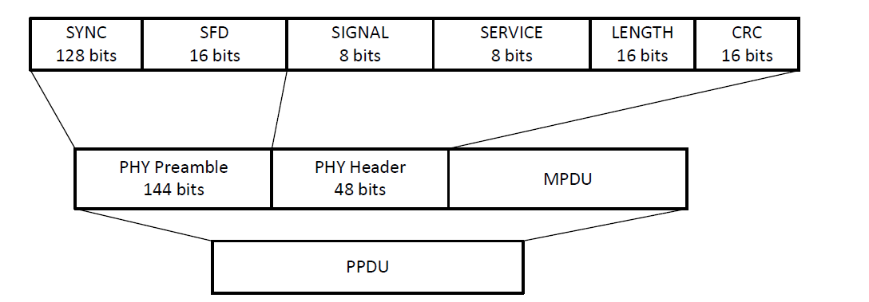
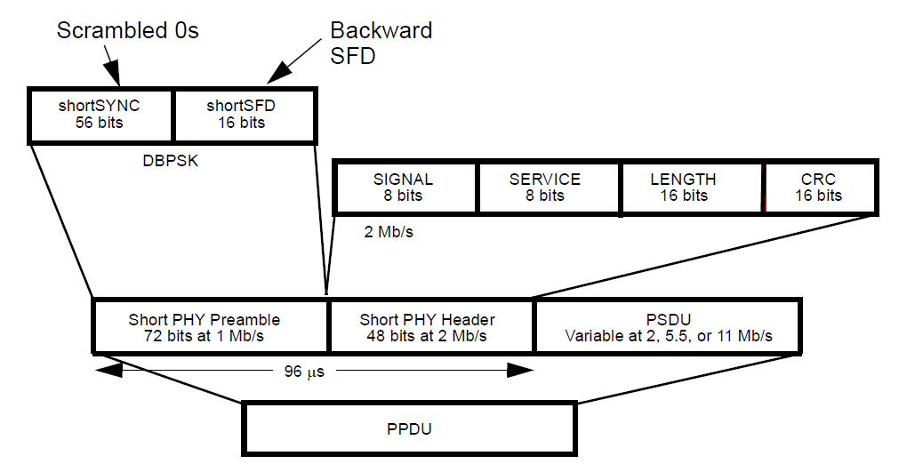
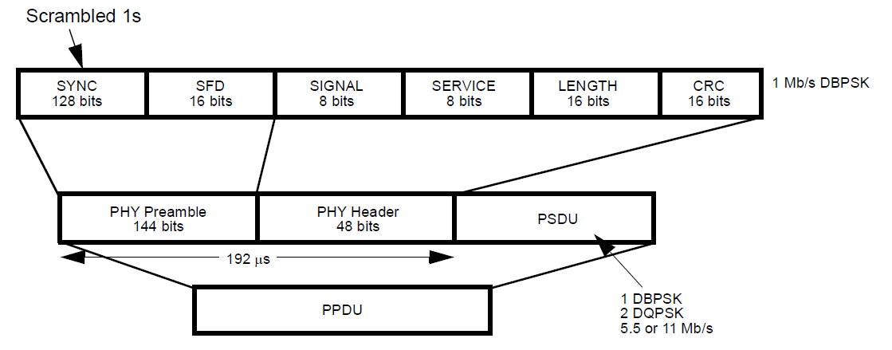
IEEE Std 802.11-2020 & IEEE Std 802.11ax-2021 4.3 Components of the IEEE 802.11 architecture 4.3.13 High-throughput (HT) STA) STA
15.3.2 DSSS PPDU format (FORMAT:NON_HT, NON_HT_MODULATION:ERP-DSSS: 1,2Mbps)
16.2 HR/DSSS PHY (NON_HT_MODULATION:ERP-CCK: 5,5,11Mb/s)
Figure 15-1—PPDU format
144=128+16
Figure 16-1—Long PPDU format
(ER Long preamble PPDU format)
Figure 16-2—Short PPDU format
(Short preamble PPDU format)

Slide 72
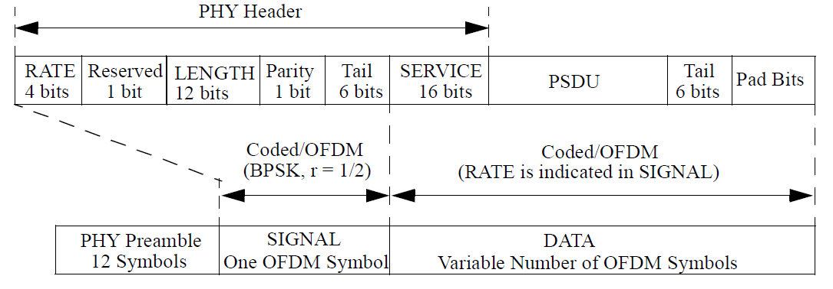
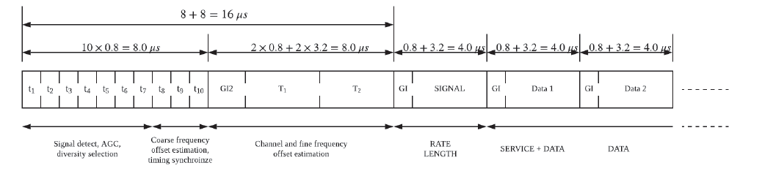
Data Link Layer IEEE 802.11-2020 Wireless LAN MAC & PHY Specifications 17. Orthogonal frequency division multiplexing (OFDM) PHY specification
17.3 OFDM PHY (20MHz, 5GHz) (NON_HT_MODULATION:ERP-OFDM or OFDM: 6, 9, 12, 18, 24, 36, 48, and 54 Mb/s)
Figure 17-1—OFDM PPDU format
(ER-OFDM PPDU)
(non-HT PPDU)
L-SIG
17.3.3 PHY preamble (SYNC)

Slide 73
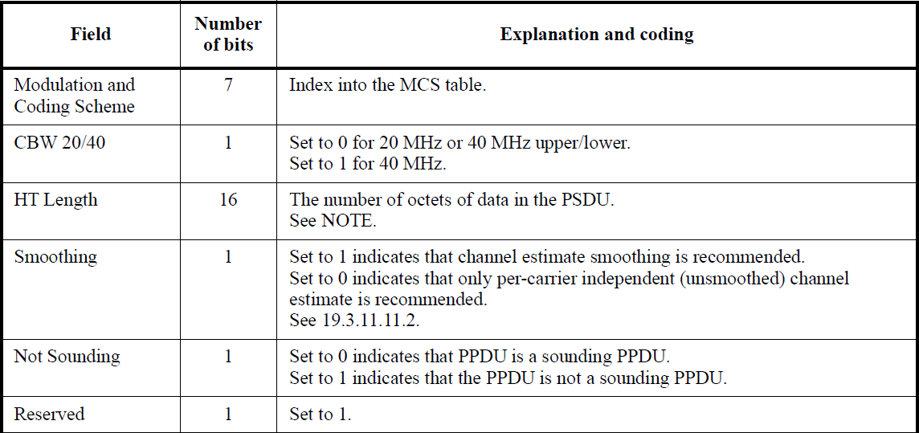
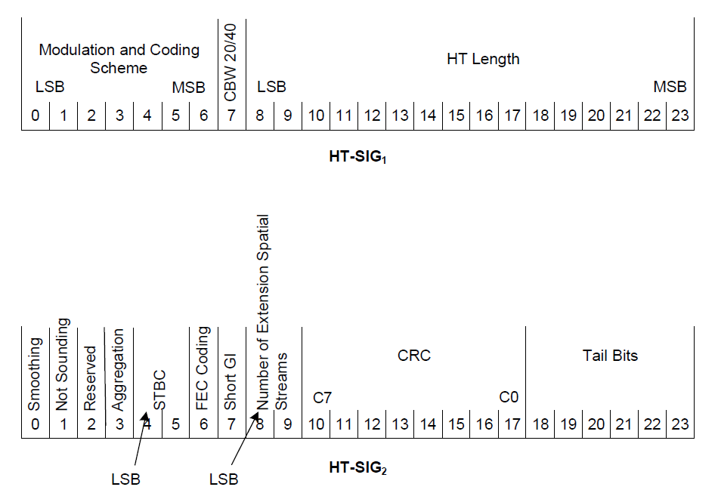
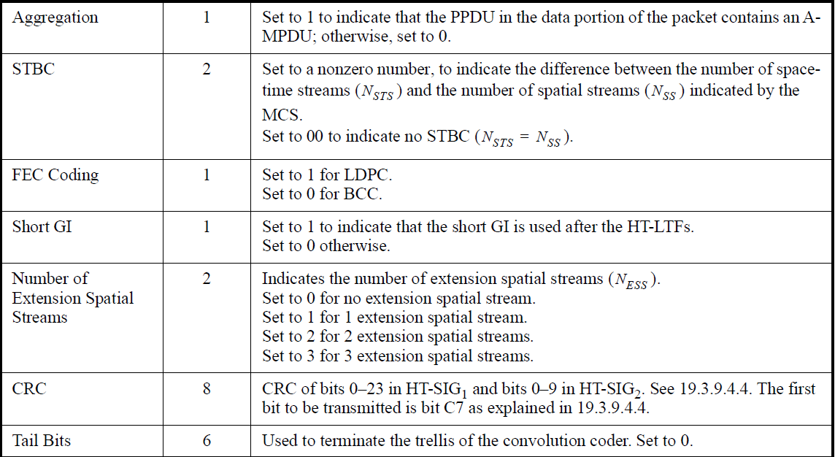
IEEE Std 802.11-2020 & IEEE Std 802.11ax-2021 19. High-throughput (HT) PHY specification
(0: No data. The packet ends after the last HT-LTF or the HT-SIG)
Figure 19-6—Format of HT-SIG1 and HT-SIG2
Table 19-11—HT-SIG fields

Slide 74
Data Link Layer IEEE 802.11-2020 Wireless LAN MAC & PHY Specifications 19.2 HT PHY service interface
19.2.2 TXVECTOR and RXVECTOR parameters
FORMAT:
NON_HT, HT_MF (HT-mixed), HT_GF (HT-greenfield)
NON_HT_ MODULATION
(FORMAT is NON_HT) ERP-DSSS, ERP-CCK, ERP-OFDM, OFDM, NON_HT_DUP_OFDM
L_LENGTH (1..4096)
(FORMAT is NON_HT) Indicates the length of the PSDU in octets.
(FORMAT is HT_MF) Indicates the value in the Length field of the L-SIG.
LENGTH (0..65535) (FORMAT is HT_MF or HT_GF) Indicates the length of an HT PSDU
L_DATARATE
(FORMAT is NON_HT) ERP-DSSS (1/2Mbps), ERP-CCK(5.5/11Mbps), ERP-OFDM, NON_HT_DUP_OFDM, OFDM (6/9/12/18/24/36/48/54Mbps)
(FORMAT is HT_MF) Indicates the data rate value that is in the L-SIG.

Slide 75
Data Link Layer IEEE 802.11-2020 Wireless LAN MAC & PHY Specifications 19.2 HT PHY service interface
19.2.2 TXVECTOR and RXVECTOR parameters
LSIGVALID (RXVECTOR only)
(FORMAT is HT_MF) (true/false) if L-SIG Parity is valid/not valid
SERVICE (TXVECTOR only)
FORMAT is NON_HT and NON_HT_MODUL ATION is ERP-OFDM/OFDM
Scrambler initialization, null
FORMAT is HT_MF or HT_GF
Scrambler initialization, null
TXPWR_LEVEL_INDEX (TXVECTOR only)
RSSI (0..255) (RXVECTOR only)
This parameter is a measure by the PHY of the power observed at the antenna connector used to receive the current PPDU.
PREAMBLE_TYPE
FORMAT is NON_HT and NON_HT_MODUL ATION is ERP-DSSS/ERP-CCK
SHORTPREAMBLE, LONGPREAMBLE

Slide 76
Data Link Layer IEEE 802.11-2020 Wireless LAN MAC & PHY Specifications 19.2 HT PHY service interface
19.2.2 TXVECTOR and RXVECTOR parameters
MCS (0..76, 77..127(Reserved))
(FORMAT is HT_MF or HT_GF) Selects the modulation and coding scheme used in the transmission of the packet.
REC_MCS (RXVECTOR Optional)
(FORMAT is HT_MF or HT_GF) Indicates the MCS that the STA’s receiver recommends.
CH_BANDWIDTH
(FORMAT is NON_HT)
NON_HT_CBW40 for non-HT duplicate format
NON_HT_CBW20 for all other non-HT formats
(FORMAT is HT_MF or HT_GF)
HT_CBW20 for 20 MHz and 40 MHz upper and 40 MHz lower modes
HT_CBW40 for 40 MHz

Slide 77
Data Link Layer IEEE 802.11-2020 Wireless LAN MAC & PHY Specifications 19.2 HT PHY service interface
19.2.2 TXVECTOR and RXVECTOR parameters
CH_OFFSET (TXVECTOR only)
CH_OFF_20 indicates the use of a 20 MHz channel (that is not part of a 40 MHz channel).
CH_OFF_40 indicates the entire 40 MHz channel.
CH_OFF_20U indicates the upper 20 MHz of the 40 MHz channel
CH_OFF_20L indicates the lower 20 MHz of the 40 MHz channel.
SMOOTHING (SMOOTHING_REC/SMOOTHING_NOT_REC)
(FORMAT is HT_MF or HT_GF) Indicates whether frequency domain smoothing is recommended as part of channel estimation.
SOUNDING (SOUNDING/NOT_SOUNDING)
(FORMAT is HT_MF or HT_GF) Indicates whether this packet is a sounding PPDU.

Slide 78
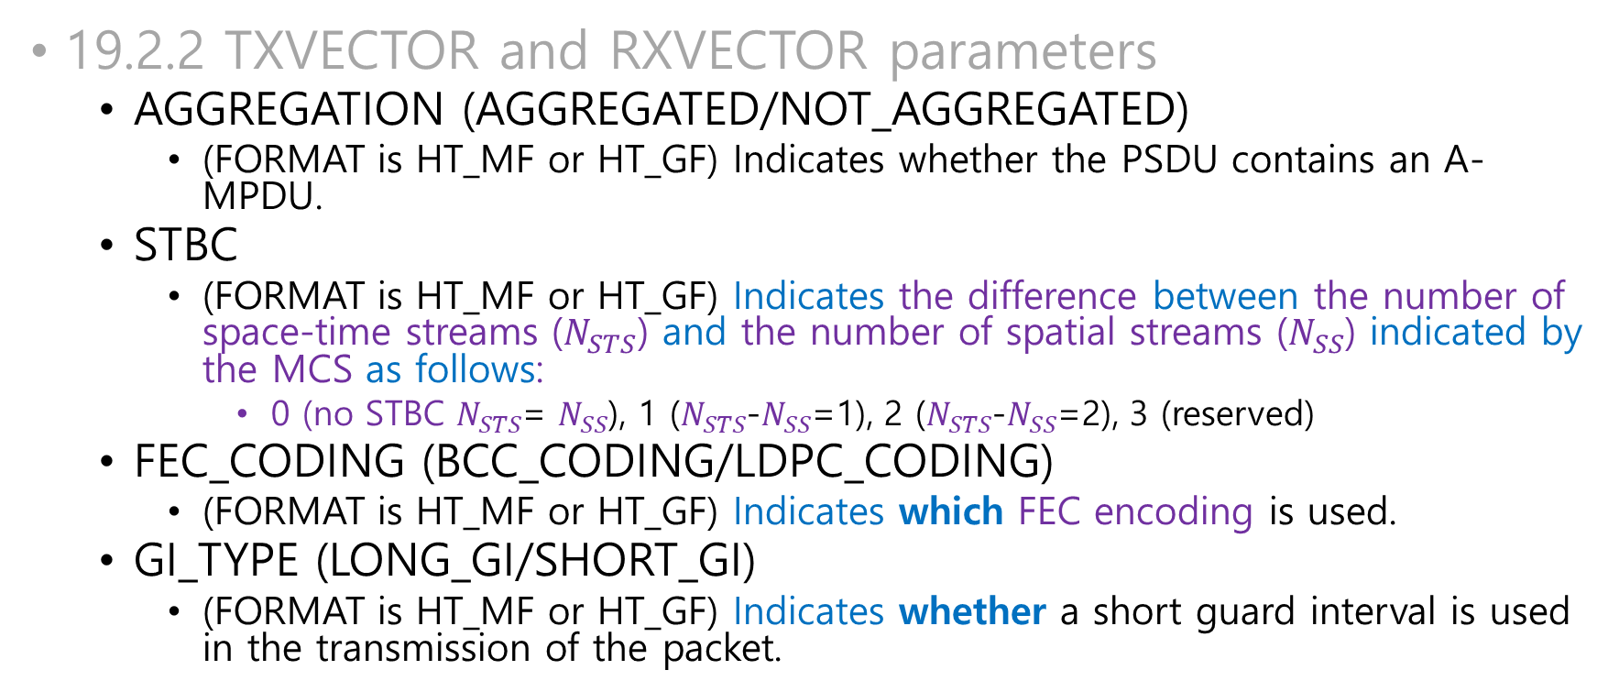
Data Link Layer IEEE 802.11-2020 Wireless LAN MAC & PHY Specifications 19.2 HT PHY service interface
19.2.2 TXVECTOR and RXVECTOR parameters
AGGREGATION (AGGREGATED/NOT_AGGREGATED)
(FORMAT is HT_MF or HT_GF) Indicates whether the PSDU contains an A-MPDU.
STBC
(FORMAT is HT_MF or HT_GF) Indicates the difference between the number of space-time streams ($N_{STS}$) and the number of spatial streams ($N_{SS}$) indicated by the MCS as follows:
0 (no STBC $N_{STS}$= $N_{SS}$), 1 ($N_{STS}$-$N_{SS}$=1), 2 ($N_{STS}$-$N_{SS}$=2), 3 (reserved)
FEC_CODING (BCC_CODING/LDPC_CODING)
(FORMAT is HT_MF or HT_GF) Indicates which FEC encoding is used.
GI_TYPE (LONG_GI/SHORT_GI)
(FORMAT is HT_MF or HT_GF) Indicates whether a short guard interval is used in the transmission of the packet.

Slide 79
Data Link Layer IEEE 802.11-2020 Wireless LAN MAC & PHY Specifications 19.2 HT PHY service interface
19.2.2 TXVECTOR and RXVECTOR parameters
NUM_EXTEN_SS
(FORNAT:HT_MF or HT_GF) Indicates the number of extension spatial streams that are sounded during the extension HT-LTFs in the range 0 to 3.
ANTENNA_SET (TXVECTOR Optional)
(FORNAT:HT_MF or HT_GF) Indicates which antennas of the available antennas are used in the transmission.
The length of the field is 8 bits
A 1 in bit position n, relative to the LSB, indicates that antenna n is used.
At most 4 bits out of 8 may be set to 1.
N_TX (TXVECTOR only)
(FORNAT:HT_MF or HT_GF) indicates the number of transmit chains

Slide 80
Data Link Layer IEEE 802.11-2020 Wireless LAN MAC & PHY Specifications 19.2 HT PHY service interface
19.2.2 TXVECTOR and RXVECTOR parameters
EXPANSION_MAT (TXVECTOR only)
(EXPANSION_MAT_TYPE is COMPRESSED_SV) Contains a set of compressed beamforming feedback matrices
(EXPANSION_MAT_TYPE is NON_COMPRESSED_SV) Contains a set of noncompressed beamforming feedback matrices
EXPANSION_MAT_TYPE is CSI_MATRICES) Contains a set of CSI matrices
EXPANSION_MAT_TYPE (TXVECTOR only)
CHAN_MAT (RXVECTOR only)
CHAN_MAT_TYPE is COMPRESSED_SV) Contains a set of compressed beamforming feedback matrices based on the channel measured during the training symbols of the received PPDU.
(CHAN_MAT_TYPE is NON_COMPRESSED_SV) Contains a set of noncompressed beamforming feedback matrices based on the channel measured during the training symbols of the received PPDU.
(CHAN_MAT_TYPE is CSI_MATRICES) Contains a set of CSI matrices based on the channel measured during the training symbols of the received PPDU.
CHAN_MAT_TYPE (RXVECTOR only)

Slide 81
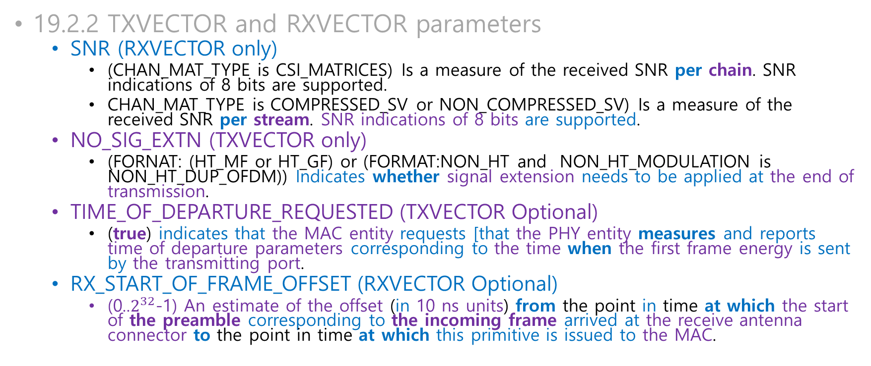
Data Link Layer IEEE 802.11-2020 Wireless LAN MAC & PHY Specifications 19.2 HT PHY service interface
19.2.2 TXVECTOR and RXVECTOR parameters
SNR (RXVECTOR only)
(CHAN_MAT_TYPE is CSI_MATRICES) Is a measure of the received SNR per chain. SNR indications of 8 bits are supported.
CHAN_MAT_TYPE is COMPRESSED_SV or NON_COMPRESSED_SV) Is a measure of the received SNR per stream. SNR indications of 8 bits are supported.
NO_SIG_EXTN (TXVECTOR only)
(FORNAT: (HT_MF or HT_GF) or (FORMAT:NON_HT and NON_HT_MODULATION is NON_HT_DUP_OFDM)) Indicates whether signal extension needs to be applied at the end of transmission.
TIME_OF_DEPARTURE_REQUESTED (TXVECTOR Optional)
(true) indicates that the MAC entity requests [that the PHY entity measures and reports time of departure parameters corresponding to the time when the first frame energy is sent by the transmitting port.
RX_START_OF_FRAME_OFFSET (RXVECTOR Optional)
(0..$2^{32}$-1) An estimate of the offset (in 10 ns units) from the point in time at which the start of the preamble corresponding to the incoming frame arrived at the receive antenna connector to the point in time at which this primitive is issued to the MAC.

Slide 82
Summary Data Transfer using IEEE 802.11

Slide 83
IEEE 802.11 WLAN Data Transfer
IPv4
ARPv4
(LSAP) DL-UNITDATA.request
ISO/IEC 8802-2:1998 LLC
RFC1042 & IEEE802-2014 (LLC/SNAP)
IEEE 802.11-2020 LPD/EPD
(MSAP) MA-UNITDATA.request
ISO/IEC 8802-2:1998 LLC
(MSAP) MA-UNITDATA.request
IEEE 802.1AC-2016
(MSAP) MA-UNITDATA.request
IEEE 802.11-2020 WLAN
LSAP
LLC sublayer (8802-2:1998)
LLC/SNAP (RFC1042 and IEEE 802-2014)
LLC (LPD/EPD) (IEEE 802.11-2020)
MSAP
IEEE 802.1AC-2016
Wireless LAN convergence function
MSAP
IEEE 802.11 WLAN

Slide 84
IEEE 802.11 WLAN Data Transfer: MAC sublayer
MA-UNITDATA.request
ISO/IEC 8802-2:1998 LLC
RFC1042 & IEEE802-2014 (LLC/SNAP)
MA-UNITDATA.request
IEEE 802.11 WLAN
The value for the duration field is calculated by the physical layer
DSAP
(AA)
SSAP
(AA)
CTL
(03)
OUI
(00 00 00)
EtherType
DATA
FC
DURATION
RA
TA
DA
SEQ
QoS
CTL
HT
CTL
MSDU
FCS
A frame from an AP to a STA

Slide 85
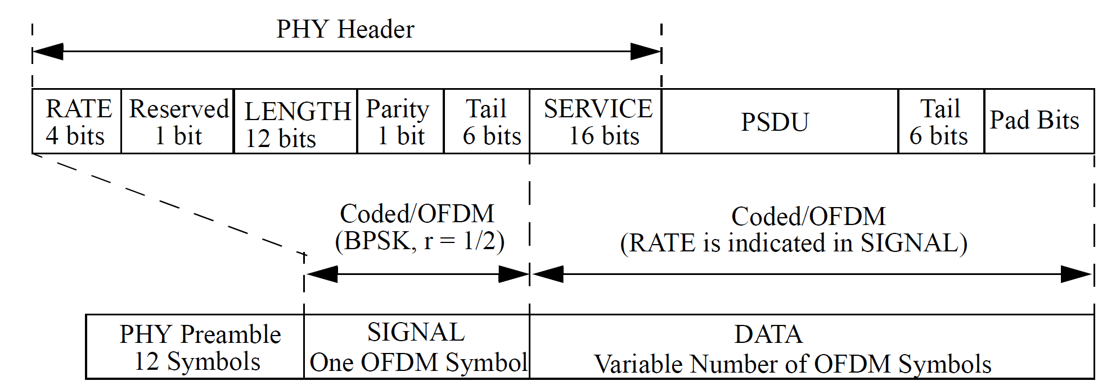
IEEE 802.11 WLAN Data Transfer: PHY Layer (OFDM)
FC
DURATION
TA
SA
DA
SEQ
QoS
CTL
HT
CTL
MSDU
FCS
IEEE 802.11: TX
PHY-CCARESET.request ()
No PHY-CCA.indication() within aCCATime
PHY-TXSTART.request(TXVECTOR)
PHY-TXSTART.confirm(TXSTATUS)
PHY-TXHEADEREND.indication
PHY-DATA.request (DATA (0x00..0xFF))
PHY-DATA.confirm()
….
PHY-DATA.request(DATA)
PHY-TXEND.request()
- Adding Tail bit and bit padding if nedded
PHY-TXEND.confirm(SCRAMBLER_OR_CRC)
IEEE 802.3 11: RX
PHY-CCA.indication(busy)
PHY-RXSTART.indication (RXVECTOR)
PHY-DATA.indication (DATA)
…..
PHY-RXEND.indication(RXVECTOR)
PHY-CCA.indication(idle)

